Slide 1

Punch Frequency Analysis
Shubha Swarnim Singh CSC-455 Dr. Brandy Wiegers

Slide 2

Introduction
Project Goal: Estimate punch frequency over a 150-second duration. (Personal data)
Methods: Lagrange, Hermite, and Cubic Spline interpolation.
Predict performance trends and guide training improvements. Applicable in real-life case for myself.

Slide 3
Dataset Overview
Data was collected every 10 seconds over a 150-second duration.
Midpoints of intervals (5, 15, ..., 145) serve as x-values.
Punch counts range 27 to 49 per interval.
Goal: Interpolate missing punch frequencies between intervals.

Slide 4
Data
No. | Time (in seconds) | Punches thrown
1 | 0-10 | 47
2 | 10-20 | 49
3 | 20-30 | 36
4 | 30-40 | 34
5 | 40-50 | 31
6 | 50-60 | 37
7 | 60-70 | 35
8 | 70-80 | 33
9 | 80-90 | 33
10 | 90-100 | 31
11 | 100-110 | 30
12 | 110-120 | 30
13 | 120-130 | 33
14 | 130-140 | 28
15 | 140-150 | 27

Slide 5
Interpolation Methods
1. Lagrange Interpolation:
Fits a single polynomial through all points.
Prone to oscillations, especially with high-degree polynomials.
2. Hermite Interpolation:
Matches both function values and derivatives.
Ensures smoother transitions.
3. Cubic Spline:
Piecewise cubic polynomials.
Maintains smoothness and continuity.

Slide 6
Findings: Lagrange Interpolation
Captures overall trends but oscillates at boundaries.
High sensitivity to rapid changes in punch frequency.
Best suited for small, evenly spaced datasets.

Slide 7
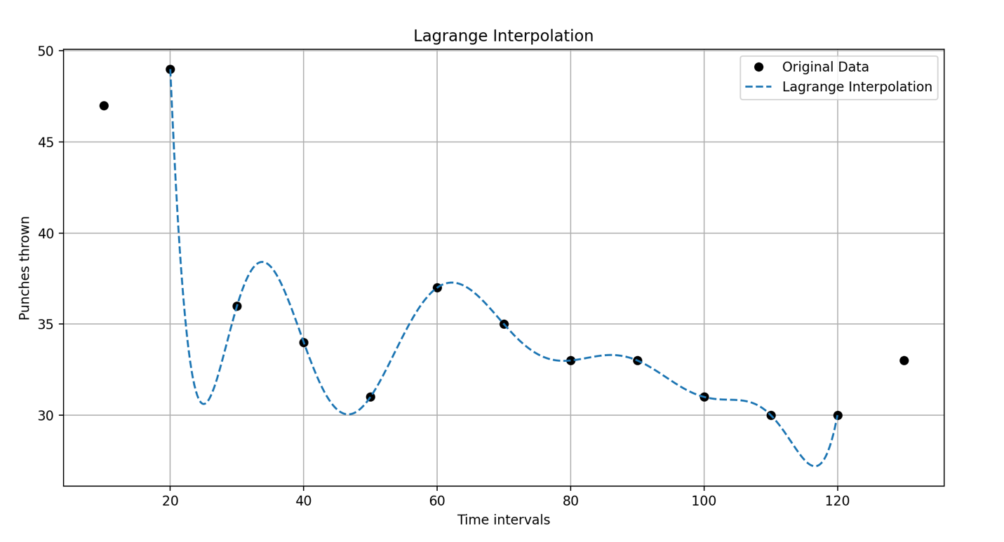
Visualization: Lagrange

Slide 8
Findings: Hermite Interpolation
Offers smooth transitions and better accuracy than Lagrange.
Slight deviations in regions with sharp changes.
Effectiveness depends on accurate derivative estimation.

Slide 9
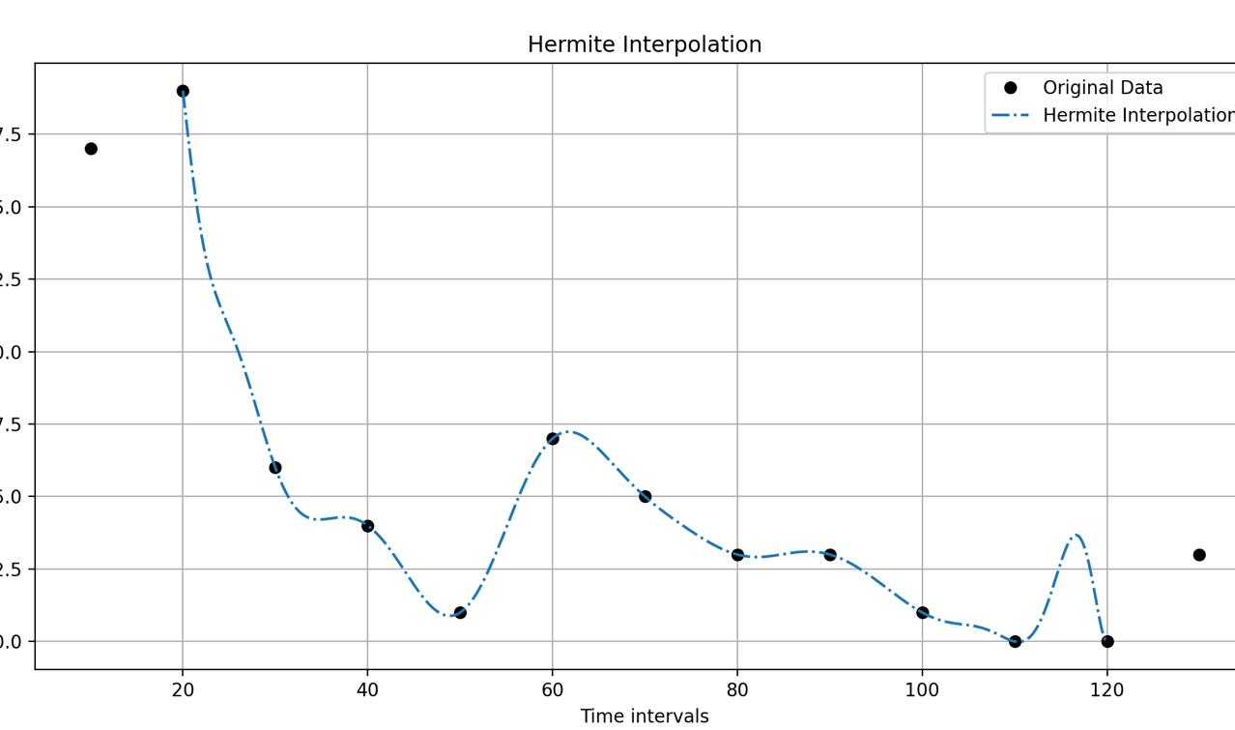
Visualization: Hermite

Slide 10
Findings: Cubic Spline Interpolation
It was smooth overall but faced coding challenges in this project.
Ideal for biological data with piecewise trends. Like this for example.
Linear output observed: Possible coding issue.

Slide 11
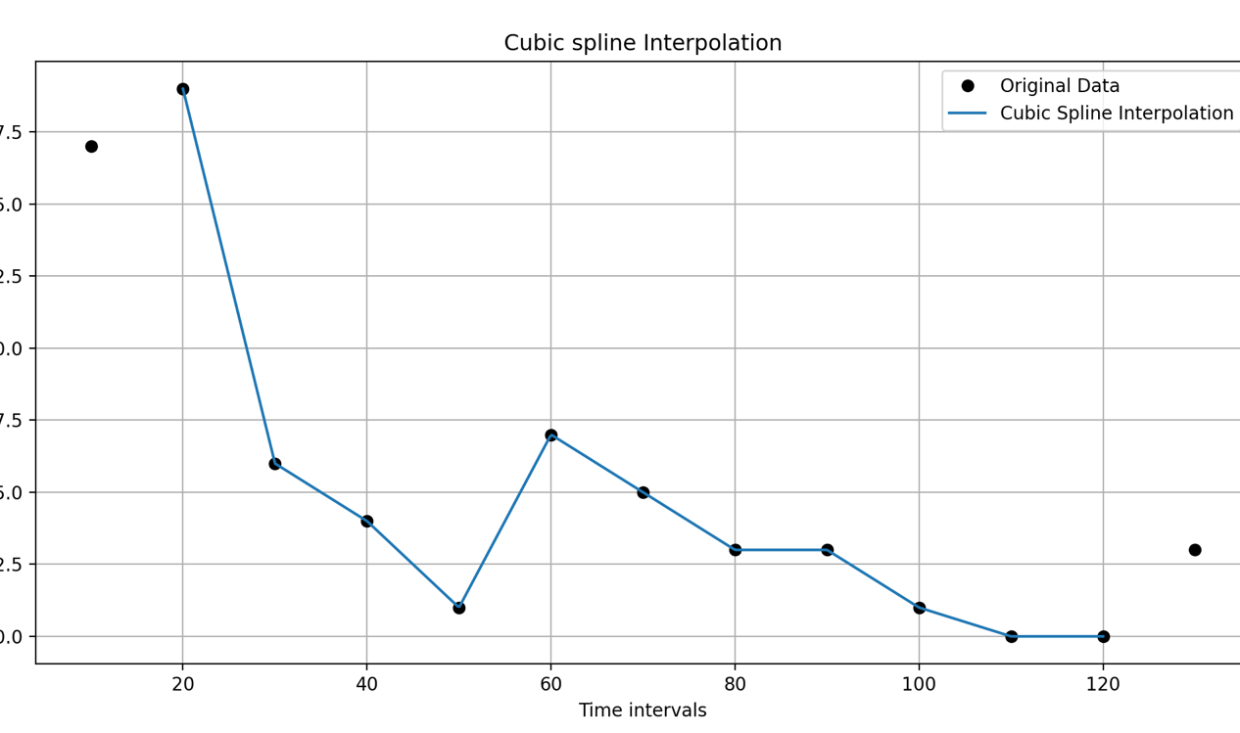
Visualization: Cubic Spline

Slide 12
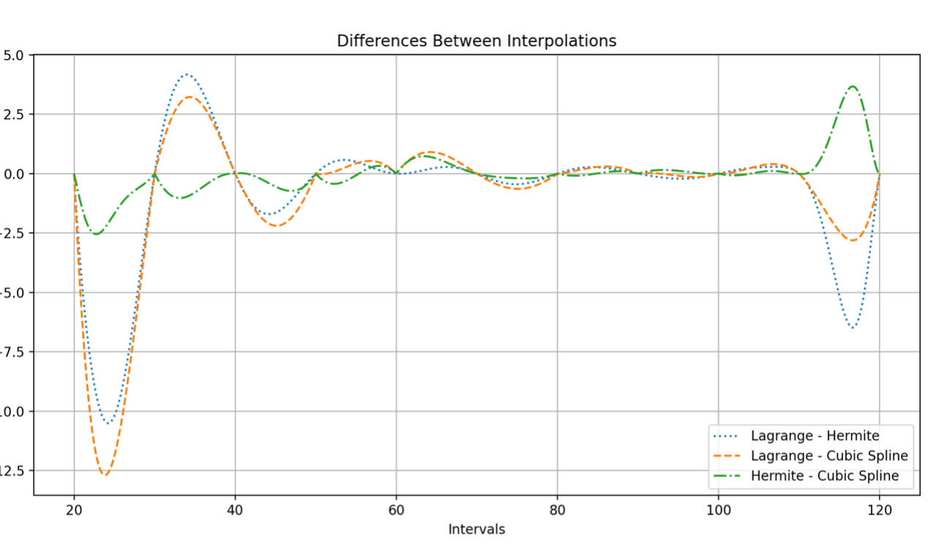
Difference between Interpolation

Slide 13
Analysis
Lagrange interpolation oscillates more, especially near the boundaries.
Hermite and Cubic Spline interpolations exhibit smaller differences, making them more consistent.
The Hermite method is smoother overall compared to Lagrange.
The variations emphasize the strengths and weaknesses of each interpolation method:
Cubic Spline(in theory) and Hermite are more stable and accurate.

Slide 14
Comparison of Methods
Lagrange: Prone to oscillations; simple but less accurate.
Hermite: Best balance of smoothness and accuracy.
Cubic Spline: Smoothest but faced implementation issues.

Slide 15
Results
All three methods provide good approximations in the middle range.
Edges exhibit high fluctuations, while the middle range offers better stability.
Cubic Spline is the smoothest method but produces straight, linear lines instead of curves. Uncertainty exists about whether this represents a "good" approximation.
Lagrange, Hermite, and Cubic Spline interpolations show notable variations, especially near the boundaries.
Lagrange interpolation is oscillatory and less stable compared to the other methods.

Slide 16
Key Findings and Conclusion
Hermite interpolation is expected to perform best for this dataset.
Cubic spline smoothness highlights its potential despite challenges.
Lagrange is less effective for datasets with sharp changes.

Slide 17

Thank You!

